Slide 1
CS440/520 Artificial Intelligence
Computer Science Department
Lecture 1:
The Foundations of AI
and Intelligent Agents
2 September 2014
Instructor: Kostas Bekris

Slide 2
What is AI?
Humanly
vs.
Rationally
Thinking
“The automation of activities that we associate with human thinking, activities such as decision-making, problem solving, learning” (Bellman, 1978) | “The study of mental faculties through the use of computational models.” (Winston, 1992)
“The art of creating machines that perform functions that require intelligence when performed by people” (Kurzweil, 1990) | “AI is concerned with rational action... and studies the design of rational agents. A rational agent acts so as to achieve the best expected outcome” (S.R. & P.N., 1995)
vs.
Acting

Slide 3
What is AI?
Humanly
vs.
Rationally
Thinking
“The automation of activities that we associate with human thinking, activities such as decision-making, problem solving, learning” (Bellman, 1978) | “The study of mental faculties through the use of computational models.” (Winston, 1992)
“The art of creating machines that perform functions that require intelligence when performed by people” (Kurzweil, 1990) | “AI is concerned with rational action... and studies the design of rational agents. A rational agent acts so as to achieve the best expected outcome” (S.R. & P.N., 1995)
vs.
Acting

Slide 4
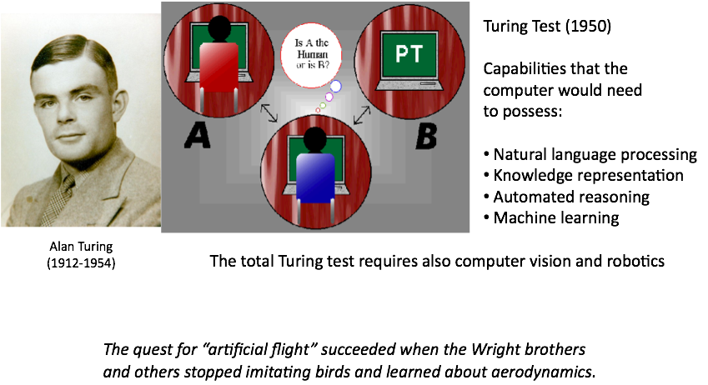
Acting Humanly

Slide 5
What is AI?
Humanly
vs.
Rationally
Thinking
“The automation of activities that we associate with human thinking, activities such as decision-making, problem solving, learning” (Bellman, 1978) | “The study of mental faculties through the use of computational models.” (Winston, 1992)
“The art of creating machines that perform functions that require intelligence when performed by people” (Kurzweil, 1990) | “AI is concerned with rational action... and studies the design of rational agents. A rational agent acts so as to achieve the best expected outcome” (S.R. & P.N., 1995)
vs.
Acting

Slide 6
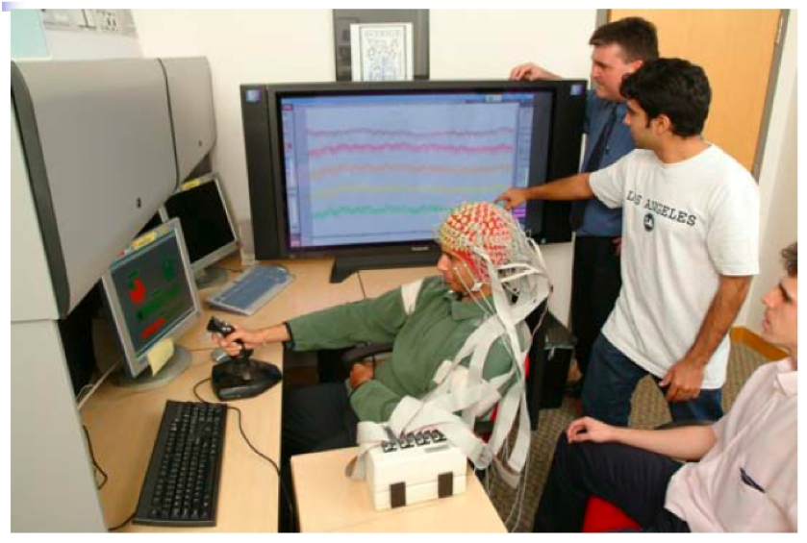
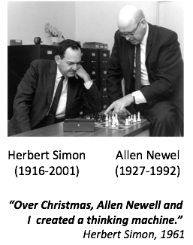
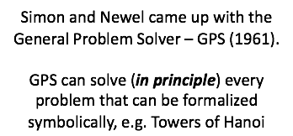

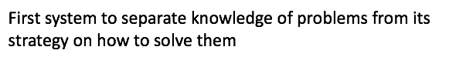
Thinking Humanly

Slide 7
What is AI?
Humanly
vs.
Rationally
Thinking
“The automation of activities that we associate with human thinking, activities such as decision-making, problem solving, learning” (Bellman, 1978) | “The study of mental faculties through the use of computational models.” (Winston, 1992)
“The art of creating machines that perform functions that require intelligence when performed by people” (Kurzweil, 1990) | “AI is concerned with rational action... and studies the design of rational agents. A rational agent acts so as to achieve the best expected outcome” (S.R. & P.N., 1995)
vs.
Acting

Slide 8
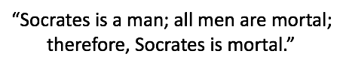
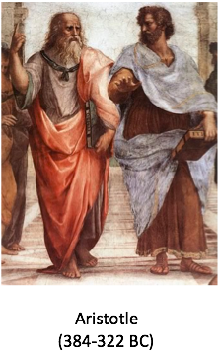
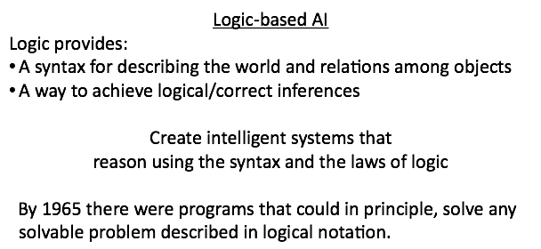
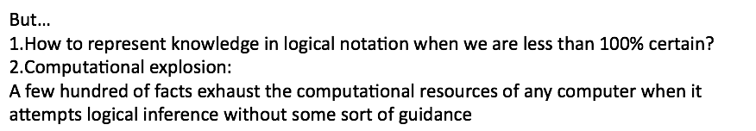
Thinking Rationally

Slide 9
What is AI?
Humanly
vs.
Rationally
Thinking
“The automation of activities that we associate with human thinking, activities such as decision-making, problem solving, learning” (Bellman, 1978) | “The study of mental faculties through the use of computational models.” (Winston, 1992)
“The art of creating machines that perform functions that require intelligence when performed by people” (Kurzweil, 1990) | “AI is concerned with rational action... and studies the design of rational agents. A rational agent acts so as to achieve the best expected outcome” (S.R. & P.N., 1995)
vs.
Acting

Slide 10

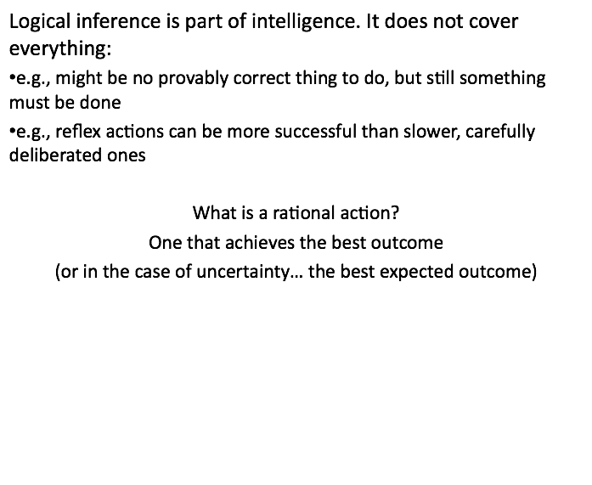
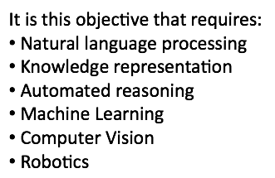
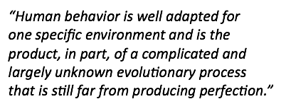
Acting Rationally

Slide 11
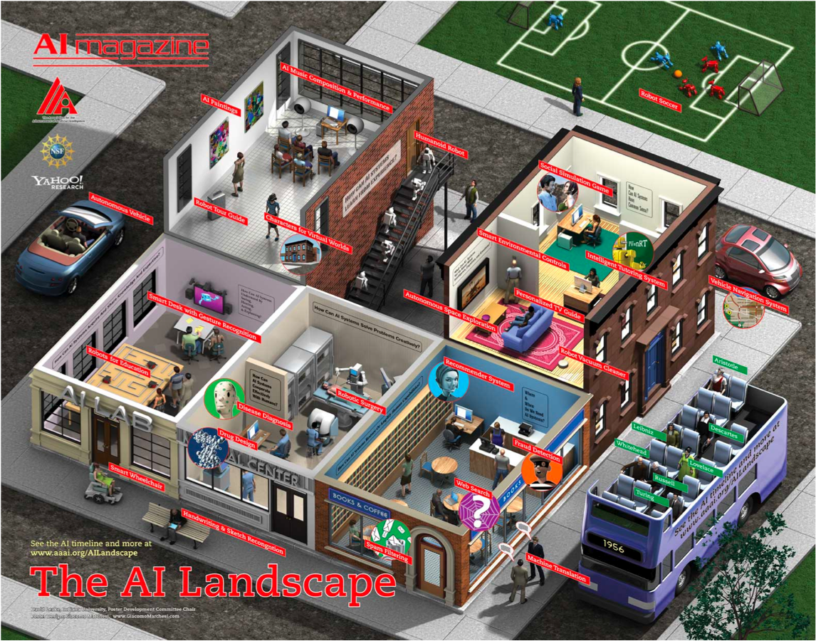

Slide 12
AAAI 2015 Topics
AI and the Web
Cognitive Modeling
Cognitive Systems
Computational Sustainability and AI
Computational Discovery
Game Theory and Economic Paradigms
Game Playing and Interactive Entertainment
Heuristic Search and Optimization
Human-Computation and Crowd Sourcing
Humans and AI
Knowledge Representation and Reasoning
Machine Learning Applications
Multi-agent Systems
Natural Language Processing (NLP) and Knowledge Representation
NLP and Machine Learning
NLP and Text Mining
Novel Machine Learning Algorithms
Planning and Scheduling
Reasoning under Uncertainty
Robotics
Search and Constraint Satisfaction
Computer Vision

Slide 13
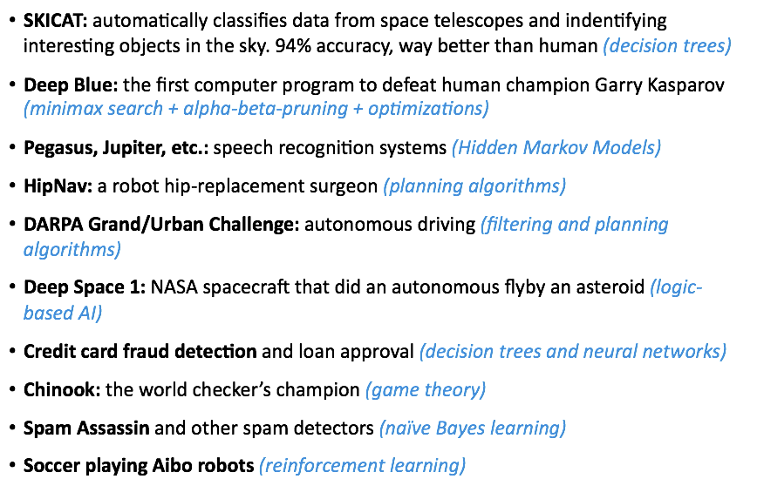
Where are we now?

Slide 14
What are my personal interests?
Robotics
Physically-Grounded
Agents
Computer Games
Human Assistants
Agents that must and do appropriately model and reason about the physical properties of their environment:
algorithmic generation of motion (motion planning)
reasoning about physical motion constraints
and achieving efficient coordination

Slide 15
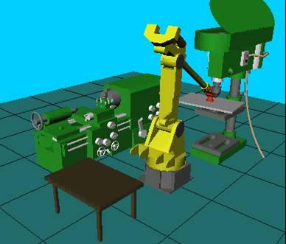
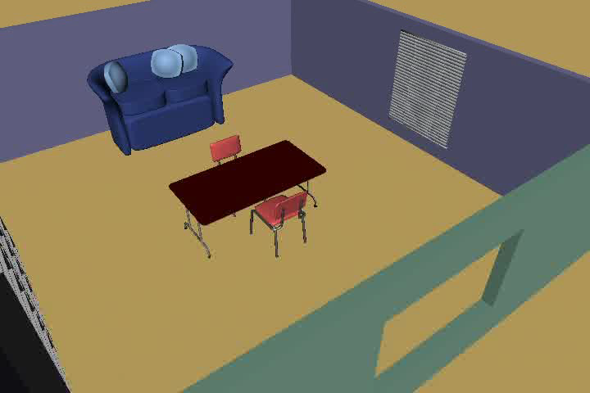
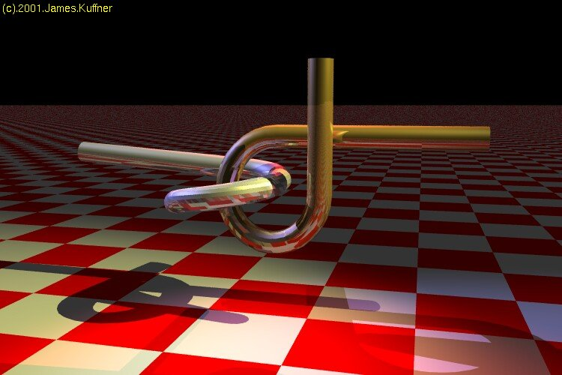
Motion Planning
Industrial Manipulation
Traditional Setup: Piano-Mover’s Problem
Jean Claude Latombe, Stanford
Geometric Problems
Kostas Bekris
James Kuffner, CMU

Slide 16
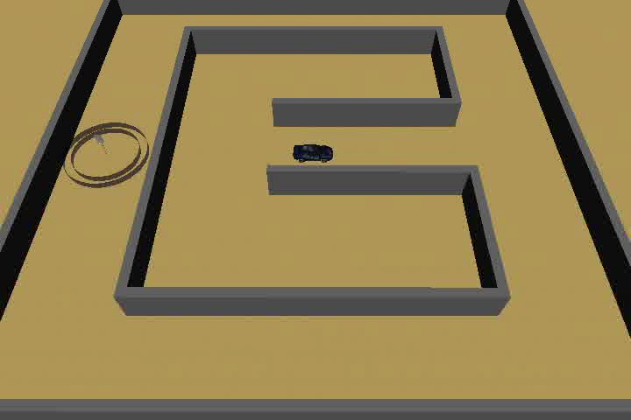
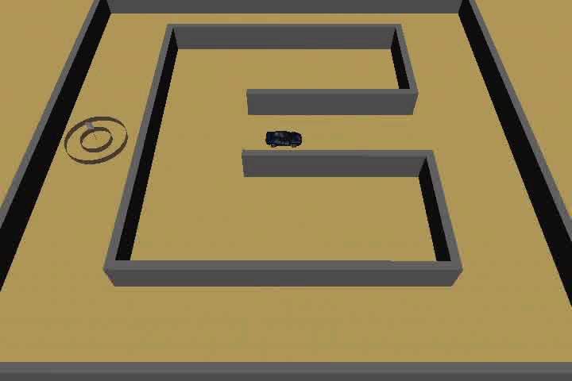
Issue: Physical Realism
Geometric Paths are not Sufficient
Lack of Physical Realism
Cannot be easily followed
Trajectory Planning:
More constrains to satisfy
non-holonomic: f(q,q) ≤ 0
underactuated systems
dynamics matter
Higher-dimensional planning
.

Slide 17
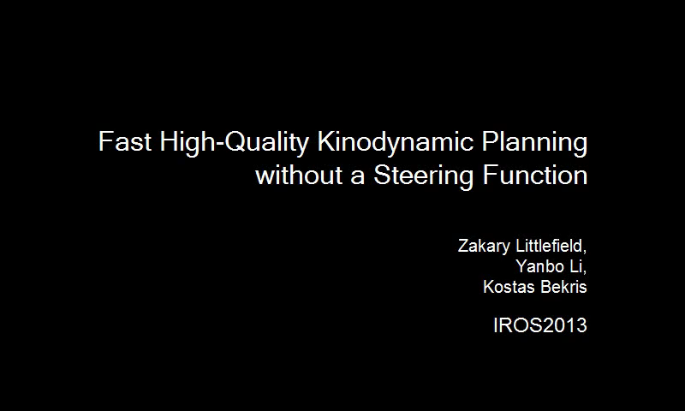
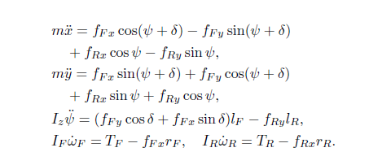
Example
“Rally Car”
Has Drift
8-dim. State Space

Slide 18
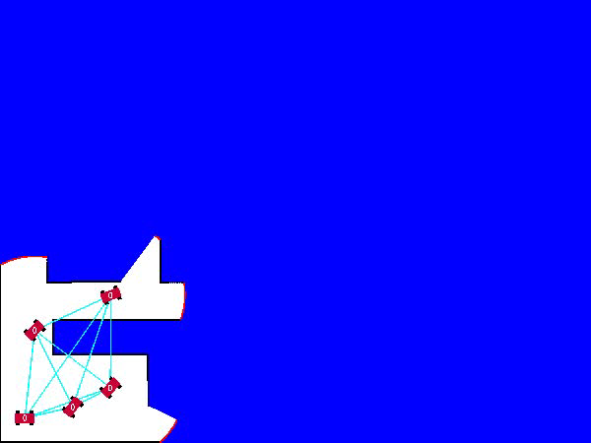
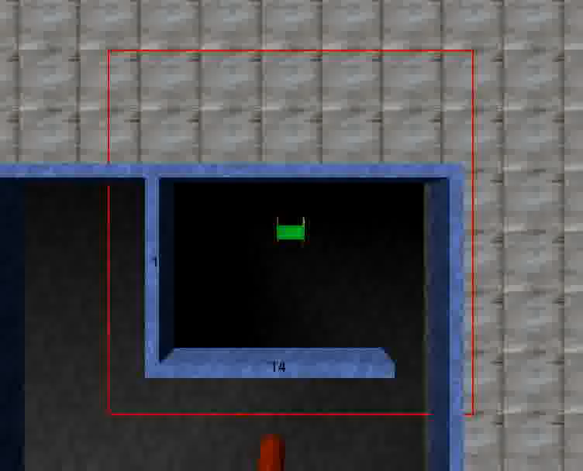
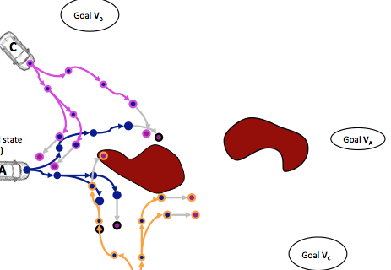
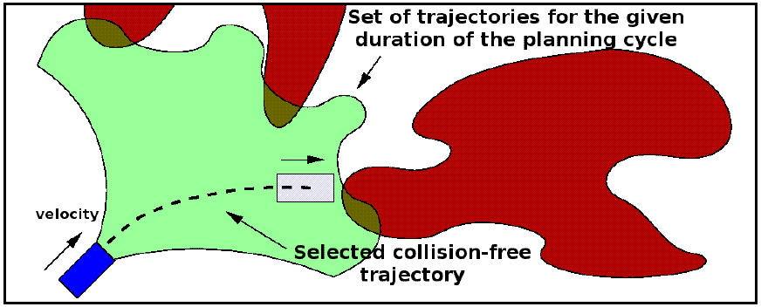
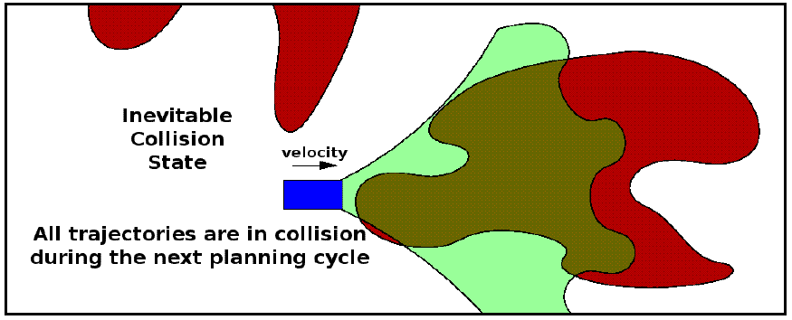
Safe Real-time Planning under Dynamics
for Robot Networks
[Bekris, Tsianos, Kavraki: RoboComm Best Paper ‘08,
Bekris, Grady, Moll, Kavraki: Intern. Journal of Robotics Research ‘12]

Slide 19
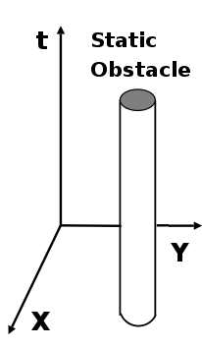
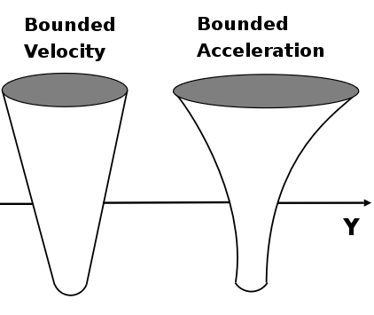
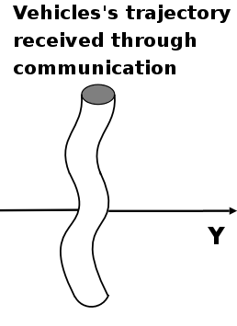
Multi-Robot Problems
Multi-Robot Problems
Autonomous Cooperating Robots
Group Constraints and Limitations
Trajectory computed from
“perfect prediction”
or communication
A
A
A
C
C
C
D
D
D
B
B
B

Slide 20

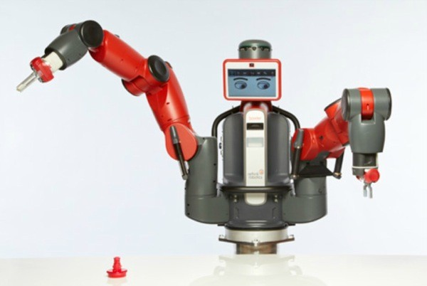
Examples

Slide 21
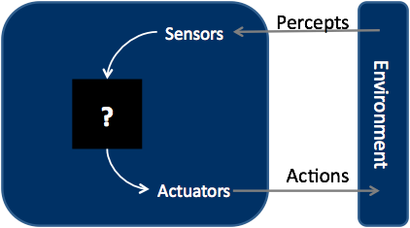
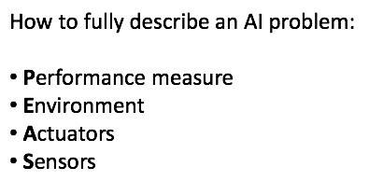
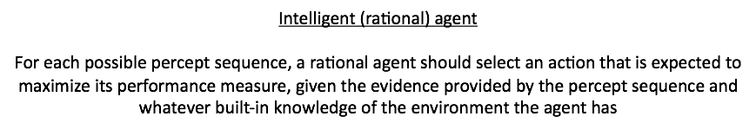
Intelligent Agents

Slide 22
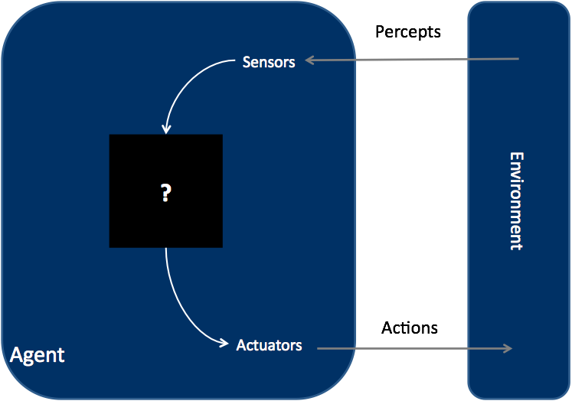
How do agents work?

Slide 23
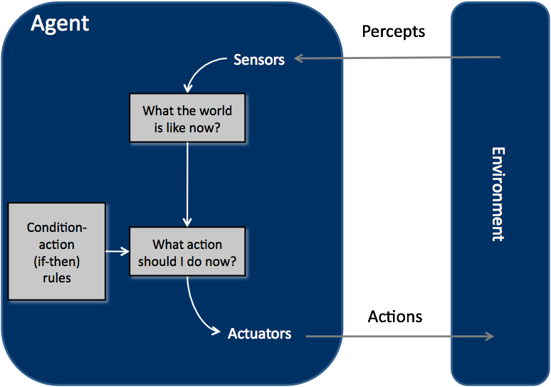
Reflex Agents

Slide 24
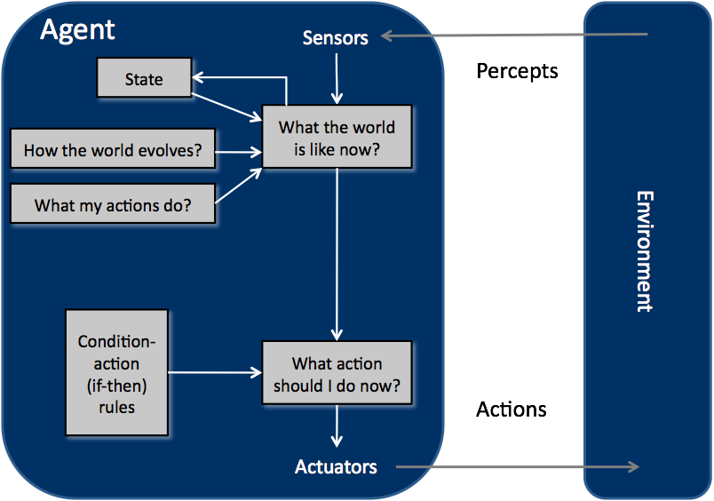
Model-based Reflex Agents

Slide 25
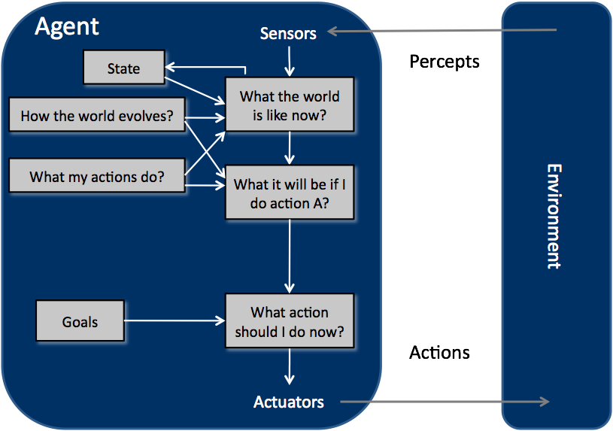
Goal-based Agents

Slide 26
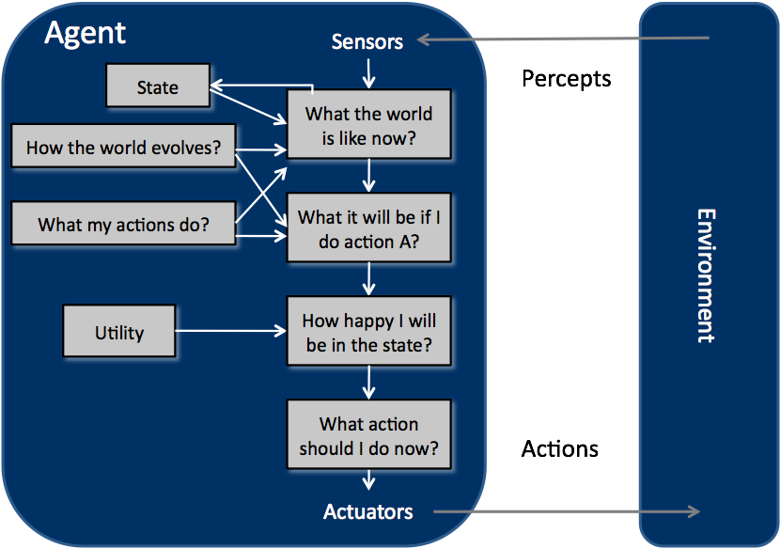
Utility-based Agents

Slide 27
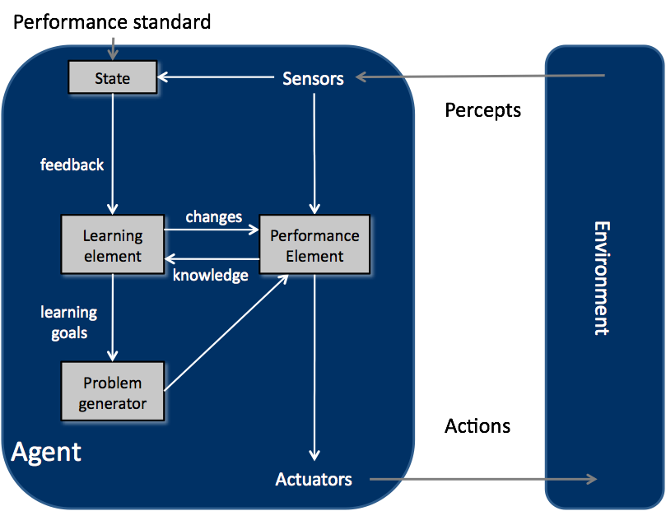
Learning Agents

Slide 28
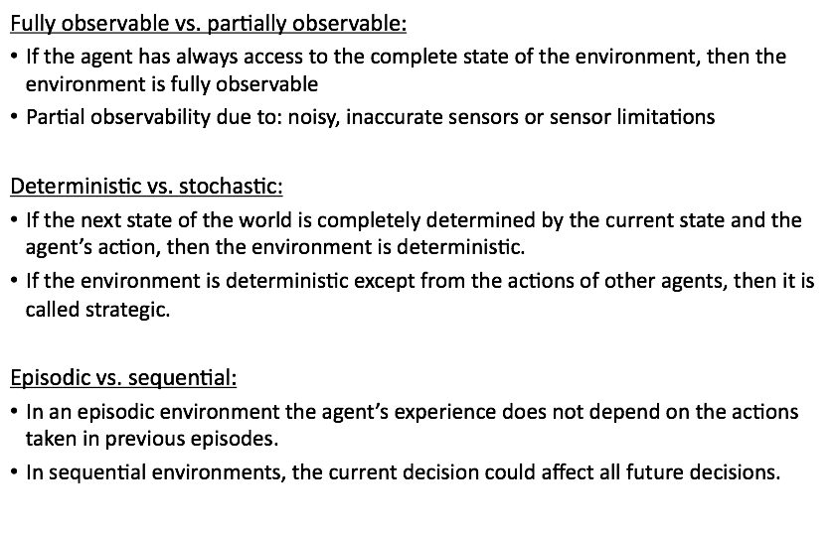
Environments and their Properties

Slide 29
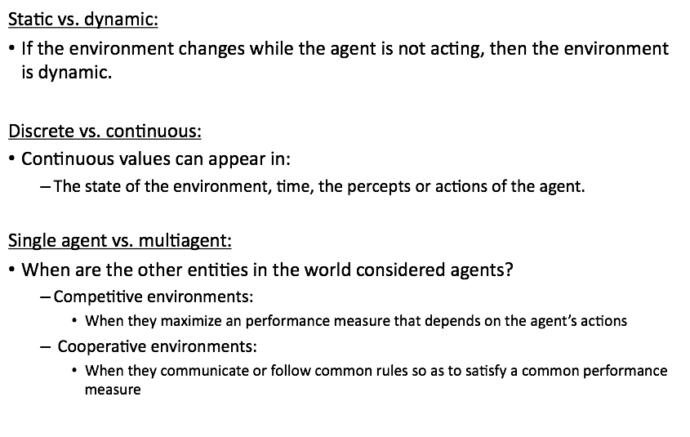
Environments and their Properties

Slide 30
Structure of the Course
Part 1
Decision-Making in Deterministic Environments
Uninformed search, informed search and heuristics, randomized and local search (genetic algorithms), adversarial search, constraint satisfaction, logic-based inference, task and path planning
Part 2
Decision-Making in Stochastic Environments
Bayesian networks, Hidden Markov Models, Kalman and Particle filters, Decision and Utility theory, Markov Decision Processes
Part 3
Learning in Unknown Environments
Supervised learning: Decision trees, Support Vector Machines, Neural Networks
Unsupervised learning: Introduction to Reinforcement Learning

